Slide 1
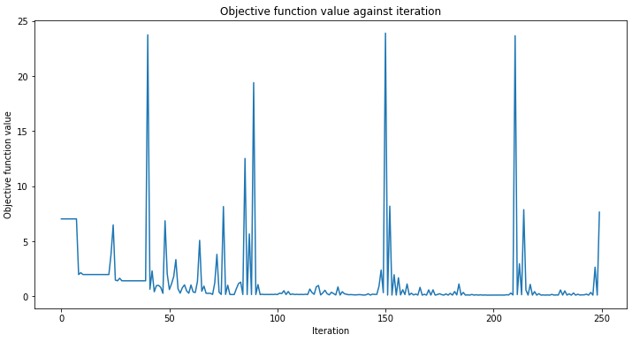
Encoding with ZFeatureMap
N_samples = 40
n_epochs = 250
Accuracy from the train data : 85.87%
Accuracy from the test data : 85.65%
RMSE: 0.06674649299174078
MSE: 0.23586754134845583
R-squared (R2) Score: 0.856494968108363

Slide 2
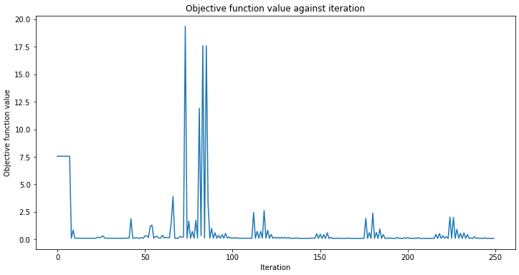
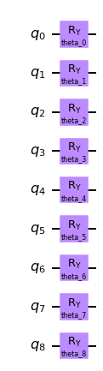
Angle Encoding
N_samples = 40
n_epochs = 250
Accuracy from the train data : 89.27%
Accuracy from the test data : 88.98%
RMSE: 0.058497287620788777
MSE: 0.21503256590108974
R-squared (R2) Score: 0.8897745997393008

Slide 3
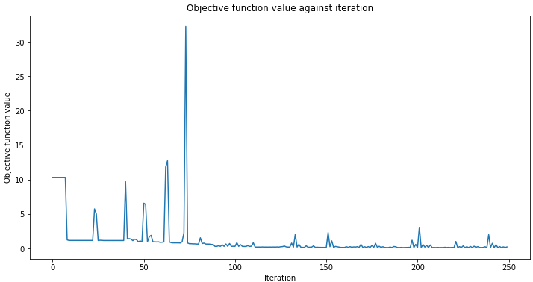
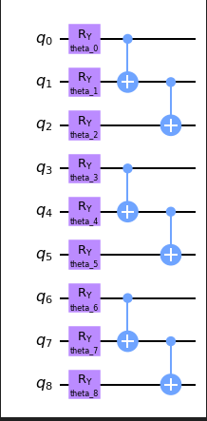
Angle Encoding with coordinate relations
N_samples = 40
n_epochs = 250
Accuracy from the train data : 87.26%
Accuracy from the test data : 84.56%
RMSE: 0.06924129844406392
MSE: 0.23080233507925502
R-squared (R2) Score: 0.845566813494679

Slide 4
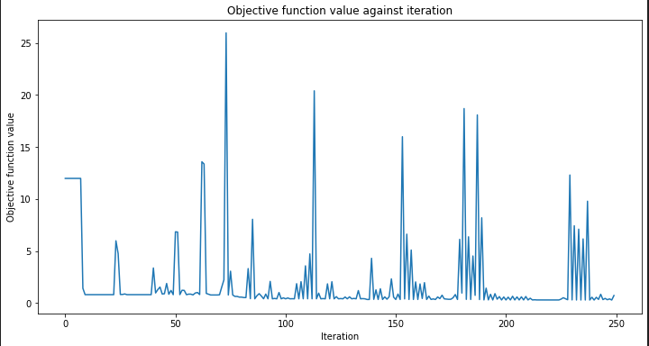
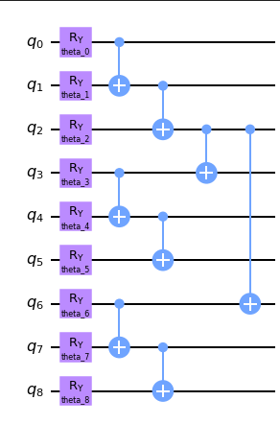
Angle Encoding with coordinate relations and single atom bondings
N_samples = 40
n_epochs = 250
Accuracy from the train data : 64.39%
Accuracy from the test data : 74.5%
RMSE: 0.08897292218813349
MSE: 0.28090957403558886
R-squared (R2) Score: 0.7450083641947102

